Slide 1

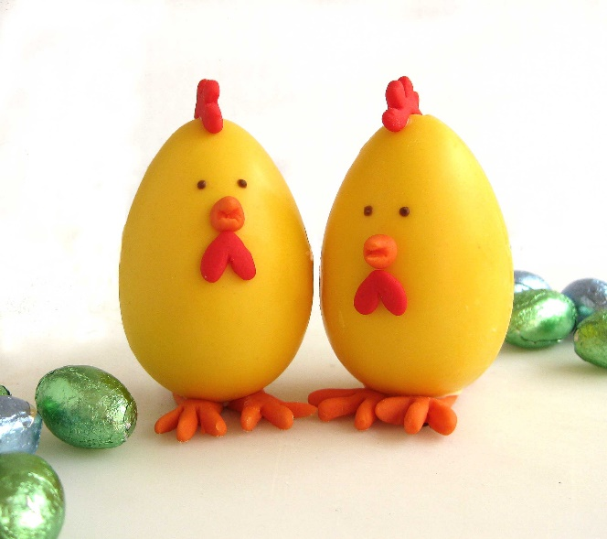

Super Eggs Trading
公司编号
Home
About us
Our Product
Contact us
We provide variety of egg based products
We manufacture and package eggs based product in a liquid form for the convenience of our customers. However, brown eggs (which is in a shell form) are sold too. There are many other products which is high quality and fresh are sold by us as well (salted egg, egg yolk, egg white), which you can check it up in the “our product” column.
Bottom part

Slide 2
*Bottom part
Address
No 6, Jalan 3 Pandan Indah Industrial Park
55100 Kuala Lumpur
Contact us
Tel：017-244 6448 (Ms Wai Whai Yee)
019-316 2070 (Mr Yap Kim Onn)
018-918 4405 (Mr Yap Zhen Hoe)
Fax: 03-4295 5762
Email
supereggs2007@gmail.com

Slide 3
Super Eggs Trading
公司编号
Home
About us
Our Product
Contact us
About US
We are dedicated to serve our customers with high quality egg-based products. We keep improving ourselves such as increase our efficiency and also seeking for better business collaboration. Besides, we are certified by the Jakim Halal authority, it proves that our hygienic conditions meet the authority’s requirements.

